Slide 1


Accuracy and Precision in Raspberry Pi 5’s Software-Reported Power Dissipation
Nilma Abbas, Jesper Nordentoft, and Maja Kirkeby

Slide 2
The motivation and problem
Raspberry Pi 5’s on-board power measurements is accessible and lightweight: could fit classroom use or testing.
Is Raspberry Pi 5’s on-board power measurements accurate and precise under controlled CPU workloads?

Slide 3
Why we do it
Energy efficiency is key to sustainable system development.
Educators and researchers need practical ways to link software load with hardware energy use.
Raspberry Pi 5 is affordable and accessible for teaching and reproducible research.

Slide 4
What we do
Investigate energy consumption of Raspberry Pi 5 under controlled CPU stress.
Loads: fixed utilizations (0,25,50,75,100%) and sweeps (0–100% in steps of 10%).
Compare Pi’s on-board PMIC readings with external Siglent reference.

Slide 5
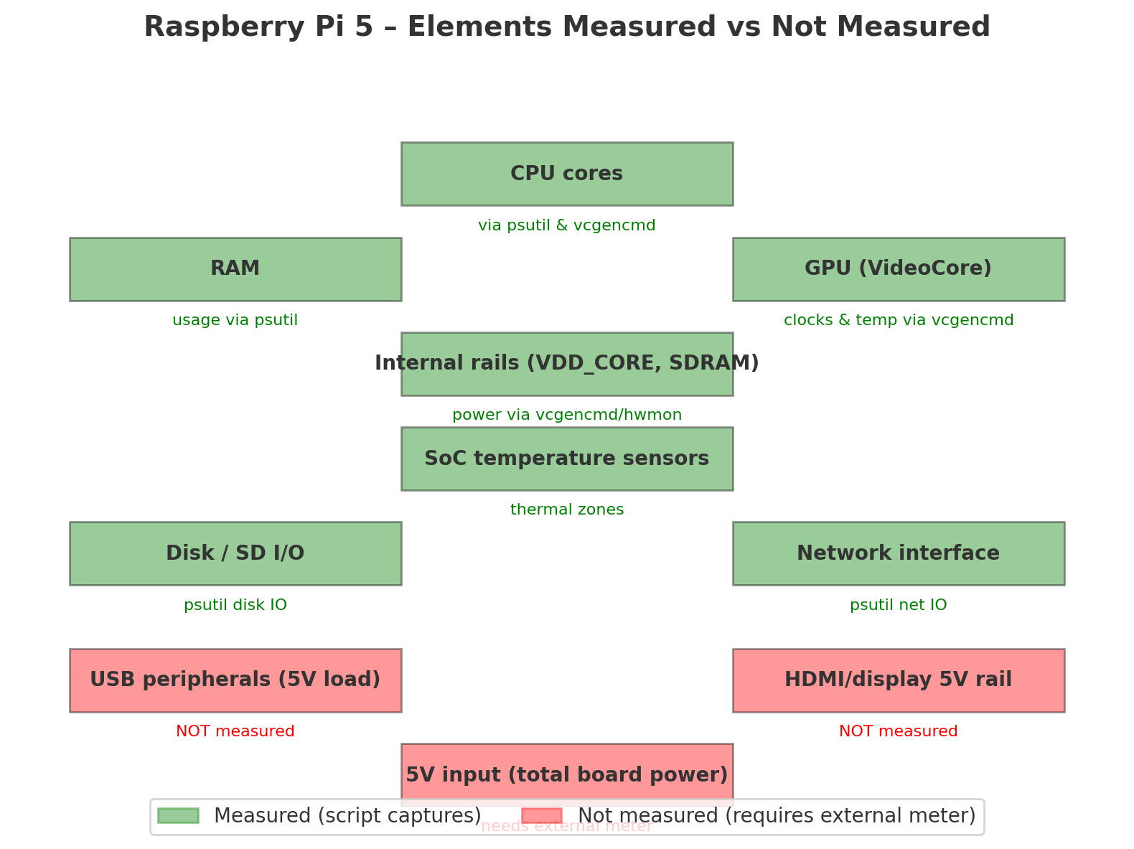
What can we measure with RP5

Slide 6
How we do it
Protocol: 20s idle rests, 80s fixed-load blocks (we use stress-ng percentage load for CPU).
Internal (Pi power logs): sampled at ~10 Hz (100 ms period).
This is fast enough to capture workload step changes (like your 20s/80s stress blocks), but it won’t resolve very short spikes (<100 ms).
External: Siglent programmable supply records reference power.
Siglent sampling frequency ≈ 2 Hz (one sample every ~0.5 s).
Analysis: mean, std, integrated energy, correlation, regression, Bland–Altman.
Notes:
In our setup, the Raspberry Pi 5’s internal power logs are sampled at ~10 Hz (100 ms), which provides sufficient temporal resolution for controlled workload experiments but may be too coarse to capture very short bursts or transient spikes in power.

Slide 7
Key Results
segment | cpu_load_% | Pi_energy_J | Pi_mean_W_via_int | Siglent_energy_J | Siglent_mean_W_via_int
idle0 | 0 | 31.617 | 395 | 153.15 | 1.914
load25 | 25 | 75.302 | 941 | 204.1 | 2.551
load50 | 50 | 93.825 | 1.173 | 225.75 | 2.822
load75 | 75 | 55.851 | 698 | 242.05 | 3.026
load100 | 100 |  |  | 255.45 | 3.193
load_% | Pi_mean_W | Siglent_mean_W | Abs_error_W | Rel_error_%
0 | 0.3957 | 1.9462 | -1.5505 | -79.67
25 | 0.9434 | 2.5682 | -1.6248 | -63.27
50 | 1.1749 | 2.862 | -1.6871 | -58.95
75 | 1.4039 | 3.0436 | -1.6397000000000002 | -53.87
100 |  | 3.2436

Slide 8
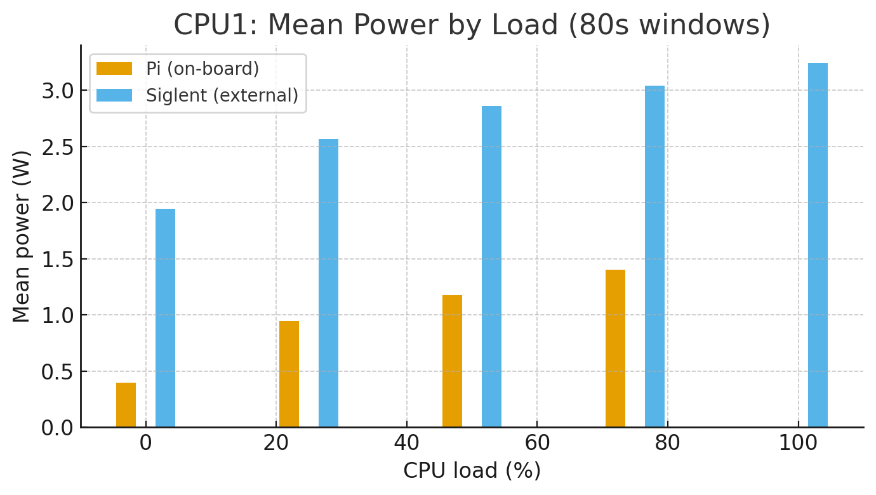
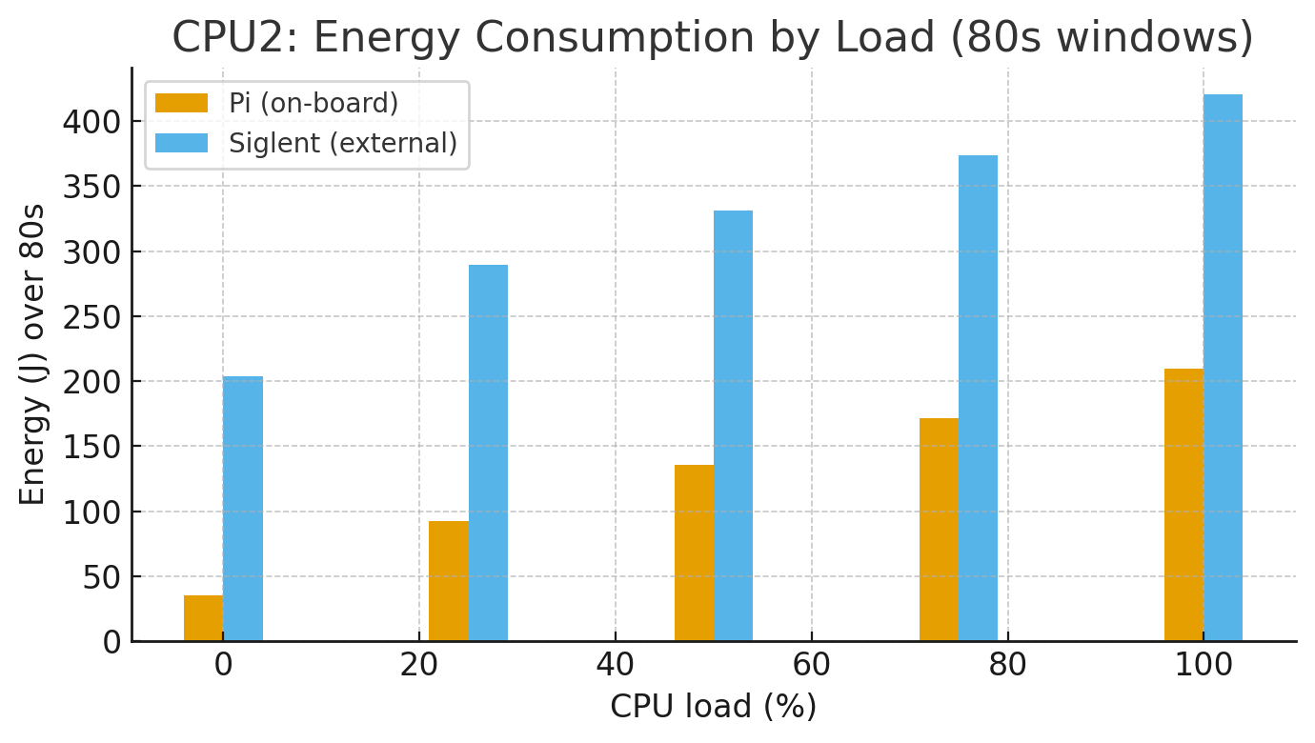
Key Results

Slide 9
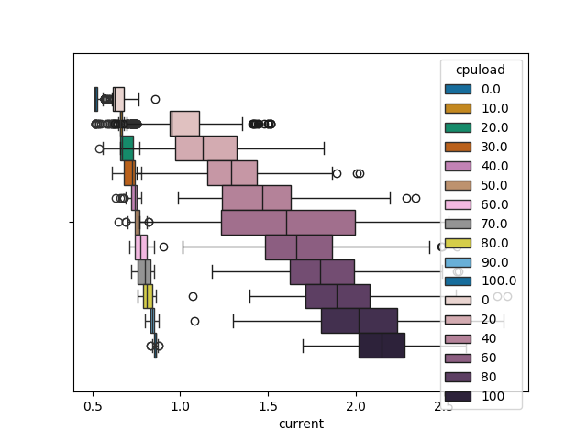
Current per CPU load
Notes:
The boxplot reveals a regression-like trend where both Siglent and Raspberry Pi energy logger readings increase with CPU load

Slide 10
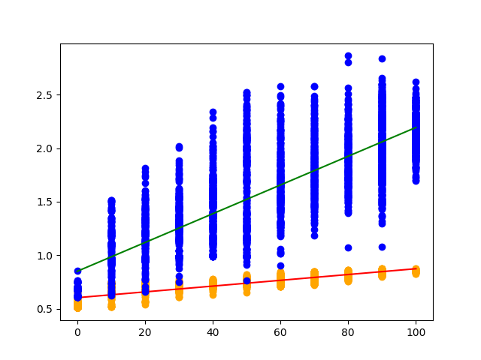
CPU load to Current Prediction
Notes:
The scatterplot shows that current increases with CPU load, with Energy Logger measurements (blue) -by the Raspberry Pi’s internal estimates- rising more steeply than the Siglent (orange), as indicated by the regression lines.

Slide 11
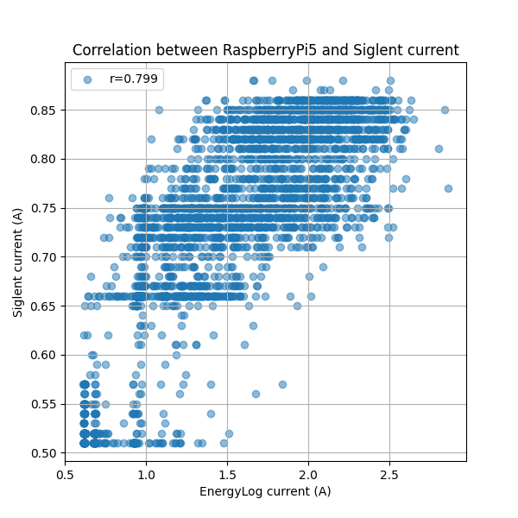
Correlation current
Notes:
Pearson’s correlation measures the strength and direction of a linear relationship between two continuous, normally distributed variables

Slide 12
Key Results
Pi systematically underreports power by ~2–2.6 W across loads.
Correlation between energy logger and Siglent time series is strong positive (r ≈ 0.799).
Energy integration confirms same bias; no hidden compensation.

Slide 13
Interpretation
As it is, 79.9% is not good enough for research
Could give a hint of the current ≈ teaching energy-efficiency (relative tracking).
The type of external measurement equipment may have reduced the correlation.
Absolute accuracy requires calibration or external meter.

Slide 14
Takeaways for Students
Understand how software load maps to energy consumption.
Learn validation/calibration of measurement tools.
Simple lab protocol: run stress-ng, record Pi+Siglent, compare.
Foundation for sustainable computing education.

Slide 15


Who
Nilma Abbas
Associate Professor at Zealand Academy of Technologies and Business
Master’s Degree in ICTE from the University of Aalborg in Copenhagen
Founder of Girls in IT Zealand

